Slide 1
Decision Tree Lecture 3 Instruction
Introduction to Data Science (IDS) course
IDS-I-L3

Slide 2
Topics
Outlier detection
Decision tree

Slide 3
Outlier detection

Slide 4
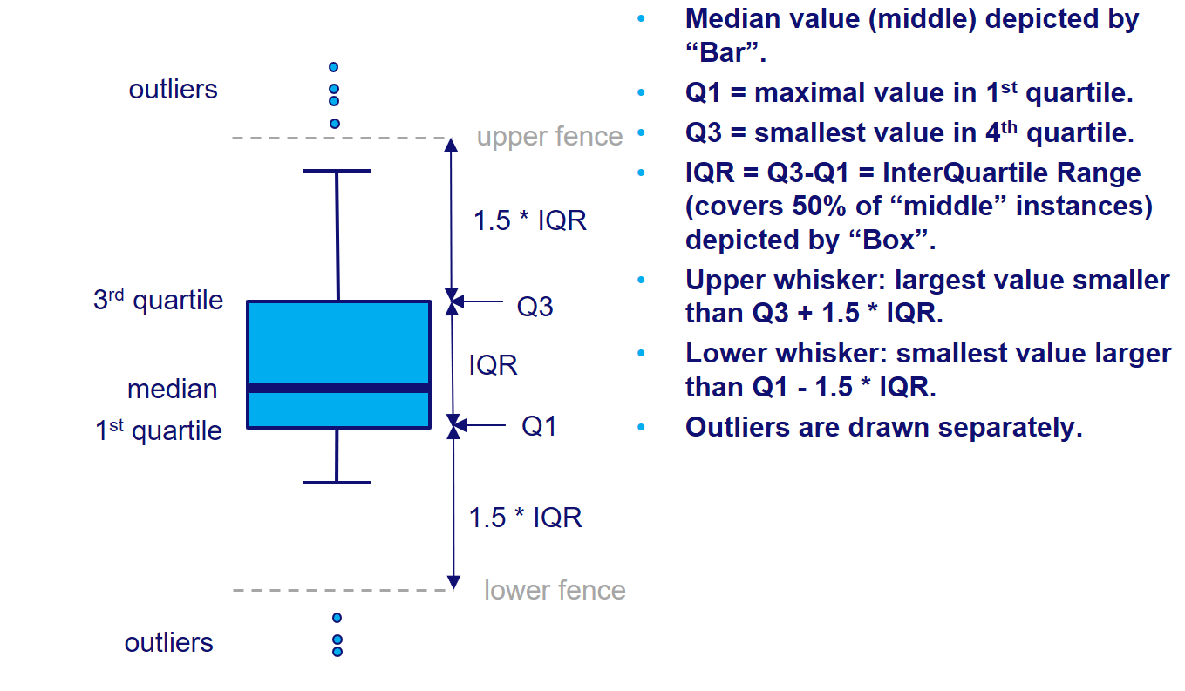
Outlier detection
Taken from the lecture slides

Slide 5
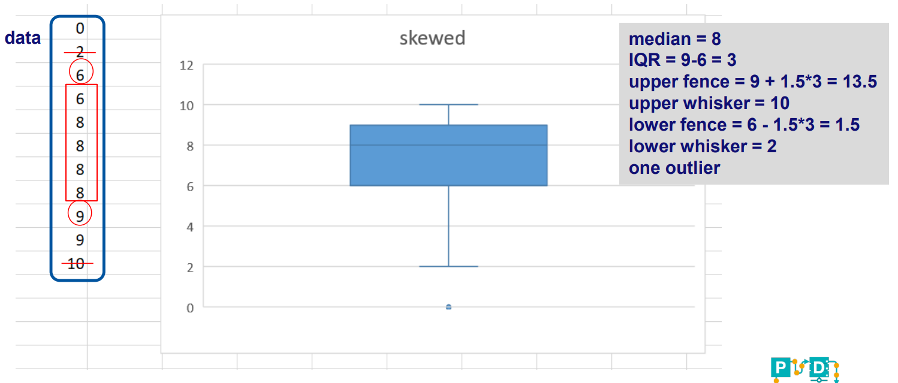
Outlier detection
Specify the quartiles!
Taken from the lecture slides

Slide 6
Decision tree

Slide 7
Q1. ID3 Complete example
Descriptive Features
Target Feature
Outlook
Outlook | Temp | Humidity | Windy | Play Golf
Rainy | Hot | High | False | No
Rainy | Hot | High | True | No
Overcast | Hot | High | False | Yes
Sunny | Mild | High | False | Yes
Sunny | Cool | Normal | False | Yes
Sunny | Cool | Normal | True | No
Overcast | Cool | Normal | True | Yes
Rainy | Mild | High | False | No
Rainy | Cool | Normal | False | Yes
Sunny | Mild | Normal | False | Yes
Rainy | Mild | Normal | True | Yes
Overcast | Mild | High | True | Yes
Overcast | Hot | Normal | False | Yes
Sunny | Mild | High | True | No
Sunny
Overcast
Rainy
Windy
Yes
Humidity
False
True
High
Normal
Yes
No
No
Yes

Slide 8
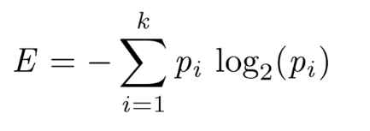

Q1. ID3 Complete example
1. Calculate entropy of the target feature.
Outlook | Temp | Humidity | Windy | Play Golf
Rainy | Hot | High | False | No
Rainy | Hot | High | True | No
Overcast | Hot | High | False | Yes
Sunny | Mild | High | False | Yes
Sunny | Cool | Normal | False | Yes
Sunny | Cool | Normal | True | No
Overcast | Cool | Normal | True | Yes
Rainy | Mild | High | False | No
Rainy | Cool | Normal | False | Yes
Sunny | Mild | Normal | False | Yes
Rainy | Mild | Normal | True | Yes
Overcast | Mild | High | True | Yes
Overcast | Hot | Normal | False | Yes
Sunny | Mild | High | True | No
Play Golf
Yes | No
9 | 5
$$Entropy \left(PlayGolf\right)=$$
$$−\left(0.36log_{2}0.36\right)−\left(0.64log_{2}0.64\right)=0.94$$

Slide 9
Q1. ID3 Complete example
2. Entropy after splitting by “Outlook”.
Outlook | Temp | Humidity | Windy | Play Golf
Rainy | Hot | High | False | No
Rainy | Hot | High | True | No
Overcast | Hot | High | False | Yes
Sunny | Mild | High | False | Yes
Sunny | Cool | Normal | False | Yes
Sunny | Cool | Normal | True | No
Overcast | Cool | Normal | True | Yes
Rainy | Mild | High | False | No
Rainy | Cool | Normal | False | Yes
Sunny | Mild | Normal | False | Yes
Rainy | Mild | Normal | True | Yes
Overcast | Mild | High | True | Yes
Overcast | Hot | Normal | False | Yes
Sunny | Mild | High | True | No
 |  | Play Golf
 |  | Yes | No
Outlook | Sunny | 3 | 2 | 5
 | Overcast
 | Rainy
 |  |  |  | 14

Slide 10
Q1. ID3 Complete example
2. Entropy after splitting by “Outlook”.
Outlook | Temp | Humidity | Windy | Play Golf
Rainy | Hot | High | False | No
Rainy | Hot | High | True | No
Overcast | Hot | High | False | Yes
Sunny | Mild | High | False | Yes
Sunny | Cool | Normal | False | Yes
Sunny | Cool | Normal | True | No
Overcast | Cool | Normal | True | Yes
Rainy | Mild | High | False | No
Rainy | Cool | Normal | False | Yes
Sunny | Mild | Normal | False | Yes
Rainy | Mild | Normal | True | Yes
Overcast | Mild | High | True | Yes
Overcast | Hot | Normal | False | Yes
Sunny | Mild | High | True | No
 |  | Play Golf
 |  | Yes | No
Outlook | Sunny | 3 | 2 | 5
 | Overcast | 4 | 0 | 4
 | Rainy

Slide 11
Q1. ID3 Complete example
2. Entropy after splitting by “Outlook”.
Outlook | Temp | Humidity | Windy | Play Golf
Rainy | Hot | High | False | No
Rainy | Hot | High | True | No
Overcast | Hot | High | False | Yes
Sunny | Mild | High | False | Yes
Sunny | Cool | Normal | False | Yes
Sunny | Cool | Normal | True | No
Overcast | Cool | Normal | True | Yes
Rainy | Mild | High | False | No
Rainy | Cool | Normal | False | Yes
Sunny | Mild | Normal | False | Yes
Rainy | Mild | Normal | True | Yes
Overcast | Mild | High | True | Yes
Overcast | Hot | Normal | False | Yes
Sunny | Mild | High | True | No
 |  | Play Golf
 |  | Yes | No
Outlook | Sunny | 3 | 2 | 5
 | Overcast | 4 | 0 | 4
 | Rainy | 2 | 3 | 5
 |  |  |  | 14

Slide 12
Q1. ID3 Complete example
2. Entropy after splitting by “Outlook”.
Outlook | Temp | Humidity | Windy | Play Golf
Rainy | Hot | High | False | No
Rainy | Hot | High | True | No
Overcast | Hot | High | False | Yes
Sunny | Mild | High | False | Yes
Sunny | Cool | Normal | False | Yes
Sunny | Cool | Normal | True | No
Overcast | Cool | Normal | True | Yes
Rainy | Mild | High | False | No
Rainy | Cool | Normal | False | Yes
Sunny | Mild | Normal | False | Yes
Rainy | Mild | Normal | True | Yes
Overcast | Mild | High | True | Yes
Overcast | Hot | Normal | False | Yes
Sunny | Mild | High | True | No
 |  | Play Golf
 |  | Yes | No
Outlook | Sunny | 3 | 2 | 5
 | Overcast | 4 | 0 | 4
 | Rainy | 2 | 3 | 5
 |  |  |  | 14

Slide 13
Q1. ID3 Complete example
2. Entropy after splitting by “Outlook”.
 |  | Play Golf
 |  | Yes | No
Outlook | Sunny | 3 | 2 | 5
 | Overcast | 4 | 0 | 4
 | Rainy | 2 | 3 | 5
 |  |  |  | 14

Slide 14

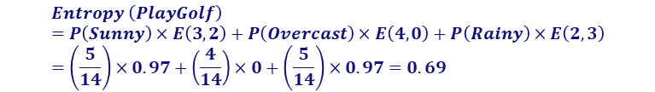

Q1. ID3 Complete example
2. Entropy after splitting by “Outlook”.
 |  | Play Golf
 |  | Yes | No
Outlook | Sunny | 3 | 2 | 5
 | Overcast | 4 | 0 | 4
 | Rainy | 2 | 3 | 5
 |  |  |  | 14
$$E\left(3,2\right)=−\left(0.6log_{2}0.6\right)−\left(0.4log_{2}0.4\right)=0.97$$
$$E\left(4,0\right)=−\left(1 log_{2}1\right)−\left(0log_{2}0\right)=0$$
$$E\left(2,3\right)=E(3,2)=0.97$$
$$Entropy \left(PlayGolf\right)=P\left(Sunny\right)×E\left(3,2\right)+P\left(Overcast\right)×E\left(4,0\right)+P\left(Rainy\right)×E\left(2,3\right)=\left(\frac{5}{14}\right)×0.97+\left(\frac{4}{14}\right)×0+\left(\frac{5}{14}\right)×0.97=0.69$$
$$Information Gain=0.94−0.69=0.25$$

Slide 15
Q1. ID3 Complete example
3. Calculate information gain after splitting by each descriptive feature.
 |  | Play Golf
 |  | Yes | No
Outlook | Sunny | 3 | 2
 | Overcast | 4 | 0
 | Rainy | 2 | 3
Gain = 0.25
 |  | Play Golf
 |  | Yes | No
Temp. | Hot | 2 | 2
 | Mild | 4 | 2
 | Cool | 3 | 1
Gain = 0.02
 |  | Play Golf
 |  | Yes | No
Humidity | High | 3 | 4
 | Normal | 6 | 1
Gain = 0.15
 |  | Play Golf
 |  | Yes | No
Windy | False | 6 | 2
 | True | 3 | 3
Gain = 0.04

Slide 16
Q1. ID3 Complete example
Outlook | Temp | Humidity | Windy | Play Golf
Sunny | Mild | High | False | Yes
Sunny | Cool | Normal | False | Yes
Sunny | Cool | Normal | True | No
Sunny | Mild | Normal | False | Yes
Sunny | Mild | High | True | No
4. Split data based on the feature which has the maximum gain, and repeat steps 1-3 for each part.
Sunny
Outlook
Overcast
Overcast | Hot | High | False | Yes
Overcast | Cool | Normal | True | Yes
Overcast | Mild | High | True | Yes
Overcast | Hot | Normal | False | Yes
Outlook
Sunny
Overcast
Rainy
Rainy | Hot | High | False | No
Rainy | Hot | High | True | No
Rainy | Mild | High | False | No
Rainy | Cool | Normal | False | Yes
Rainy | Mild | Normal | True | Yes
Rainy
Yes

Slide 17
Q1. ID3 Complete example
boxes: the main body of the boxplot showing the quartiles and the median's confidence intervals if enabled.
medians: horizontal lines at the median of each box.
whiskers: the vertical lines extending to the most extreme, non-outlier data points.
caps: the horizontal lines at the ends of the whiskers.
fliers: points representing data that extend beyond the whiskers (fliers).
means: points or lines representing the means.
Outlook | Temp | Humidity | Windy | Play Golf
Sunny | Mild | High | False | Yes
Sunny | Cool | Normal | False | Yes
Sunny | Cool | Normal | True | No
Sunny | Mild | Normal | False | Yes
Sunny | Mild | High | True | No
Sunny
Outlook
Sunny
Overcast
Rainy
Outlook
Overcast
Overcast | Hot | High | False | Yes
Overcast | Cool | Normal | True | Yes
Overcast | Mild | High | True | Yes
Overcast | Hot | Normal | False | Yes
Windy
Yes
False
True
Rainy | Hot | High | False | No
Rainy | Hot | High | True | No
Rainy | Mild | High | False | No
Rainy | Cool | Normal | False | Yes
Rainy | Mild | Normal | True | Yes
Rainy
Yes
No

Slide 18
Q1. ID3 Complete example
Outlook | Temp | Humidity | Windy | Play Golf
Sunny | Mild | High | False | Yes
Sunny | Cool | Normal | False | Yes
Sunny | Cool | Normal | True | No
Sunny | Mild | Normal | False | Yes
Sunny | Mild | High | True | No
Sunny
Outlook
Sunny
Overcast
Rainy
Outlook
Overcast
Overcast | Hot | High | False | Yes
Overcast | Cool | Normal | True | Yes
Overcast | Mild | High | True | Yes
Overcast | Hot | Normal | False | Yes
Windy
Yes
Humidity
False
True
High
Normal
Rainy | Hot | High | False | No
Rainy | Hot | High | True | No
Rainy | Mild | High | False | No
Rainy | Cool | Normal | False | Yes
Rainy | Mild | Normal | True | Yes
Rainy
Yes
No
No
Yes

Slide 19
Q2. Your Turn
Suppose that the following data is about accepting or rejecting job applications based on “Experience”, “Degree”, and type of the job (“Job”) that applicants applied for it. What is the decision tree for the following data set based on entropy?
Experience | Degree | Job | Class
Exp >10 | HS | Board | No
5< Exp <10 | Uni | Board | Yes
Exp >10 | HS | Board | No
5< Exp <10 | HS | Hcare | Yes
Exp < 5 | HS | Hcare | Yes
Exp < 5 | HS | Board | No
Exp < 5 | None | Edu | No
Exp >10 | None | Hcare | No
Exp < 5 | Uni | Edu | Yes
Exp >10 | Uni | Board | Yes

Slide 20
Q3. Numerical Descriptive Features
What are possible categories for “Experience” feature?
Experience | Degree | Job | Class
12 | HS | Board | No
20 | Uni | Board | Yes
15 | HS | Board | No
10 | HS | Hcare | Yes
3 | HS | Hcare | No
7 | HS | Board | Yes
5 | None | Edu | No
2 | None | Hcare | No
6 | Uni | Edu | Yes
11 | Uni | Board | Yes

Slide 21
Q4. Numerical Target Feature
Suppose that we have the following leaves after splitting the data set. Which classification is better and why?
Descriptive Features
Target Features
Experience | Degree | Job | Salary (K)
* | * | * | 20
* | * | * | 40
* | * | * | 50
* | * | * | 65
* | * | * | 70
* | * | * | 25
* | * | * | 95
* | * | * | 100
* | * | * | 110
* | * | * | 45
Leaf 1
20
100
40
95
Leaf 2
50
65
70
110
Leaf 3
45
25
Leaf 1
70
100
110
95
Leaf 2
40
45
65
50
Leaf 3
25
20

Slide 22
Q5. Homework
We would like to predict the sex of a person based on two binary attributes: leg-cover (pants or skirts) and facial-hair (some or none). We have a data set of 1000 individuals, half male and half female. 50% of females wear skirt, and no male wears skirt. 75% of males and 25% of females have facial hair.
Which attribute should be used as the root of the decision tree based on Entropy?
What if we use Gini index or Information gain ratio?

